Slide 10
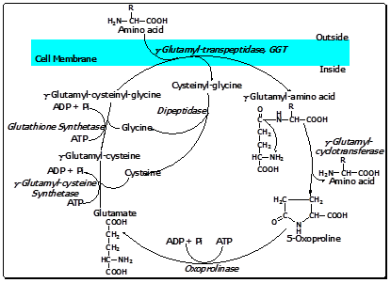

Slide 20
thanks

